Slide 1
Introduction to Financial Management
Nature of Financial Management
Why finance within an organization?
Functions of Financial Management
Financial Goals

Slide 2
Introduction
Financial Management is concerned with management of funds in context of business
Finance
For example: If one big project is to be estimated, what sort of financial decision might be involved:
Public (management of funds of government)
Private (Personal)
(Funds of individual)
Business (decision making on managerial decision, investment decision and asset management decision

Slide 3
Continue…
1st : Estimate cost and benefit and make capital expenditure decision / investment decision
2nd : Manage funds for expenditure ( financing decision)
3rd: Management of acquired assets (Assets management decision
Financial management is concerned not only with the financing decision but also with investment and assets management decision

Slide 4
Importance of Financial Management
1. Coping with ever changing market segments
(merger, liquidation, takeover, IPO, FPO)
2. Undertaking Correct Investment Decision
estimating cost benefit, selection of best and maximization of wealth
3. Undertaking Correct Financing Decision
Debt or Equity ( if debt: long term or short term)
Minimize cost and maximize the wealth
4. Efficient working capital Management
(investment on inventory, receivable and other liquid assets)
5. Optimal Dividend Policy Decision
which form (cash or stock) and timing of dividend

Slide 5
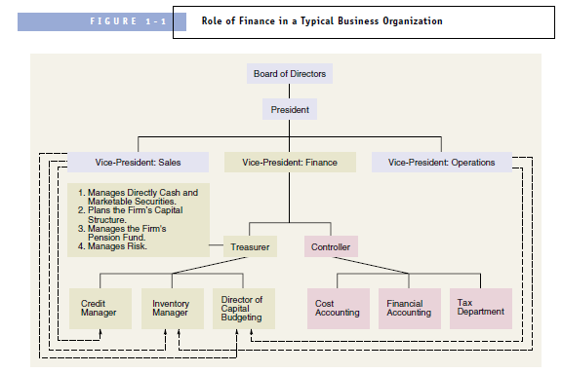
Finance with in an organization

Slide 6
Goals of Financial Management
Goals are the purpose for which finance functions are carried out
Profit maximization Goal
Action that increase profit should be undertaken and those that decrease profit are to be avoided
Favor of Profit Maximization:
Profit is test of economic efficiency
Effective utilization of scare economic resources
Leads to total economic welfare
Criticism of Profit Maximization
Ambiguity (PAT or EBIT ; short term or long term, gross or net)
e.g issuing share and using proceeds in Treasury Bills can maximize profit but result decrease in EPS
Ignores Time value of money
Ignore Quality of Benefits
Unsuitable in Modern Business Environment (increase conflict among stakeholders

Slide 7
Goals of Financial Management
2. Wealth Maximization Goal
Managers should take decision that maximize the shareholder’s wealth
Project should generate positive Net Present Value (NPV = PV benefit – PV of cost)
Arguments in favor of wealth maximization:
Goal is clear (cost and benefit measured in terms of cash flow)
Consider Timing of cash flow
Consider quality of benefits (quality refers to certainty of cash flow)
Reduce conflict of Interest among stakeholders of firm. How
Allocate scare resources efficiently
Requires low cost business and high quality goods and services
Creditors must be paid before anything to be paid to stockholders
Employees are fairly compensated

Slide 8
Relationship between Profit Maximization and Stock Price Maximization
Maximization of profit is an important variable but it alone does not necessarily maximize the stock price in the stock market.
Other Variables Like:
Prospects of Dividends
Growth of Dividends
Investment opportunities and risk in firm
Quality of management
Also plays important role in the maximization of stock price

Slide 9
Agency Relationship
Relationship between principal and agent
In financial management relationship between shareholders and managers can be viewed as principal and agent
Problem in the relationship is called as Agency Problem
Two Types of Agency Problem
Between shareholders and Managers
Between shareholders and Creditors/ Bond holders

Slide 10
Business Ethics and Social Responsibility
Ethics: Moral principles that controls or influence a person’s behaviors
Business Ethics: also known as managerial ethics
Company’s attitude and conduct towards its employees, customers, community and stock holders
3 areas of concern of business ethics
How a corporation treats its employees
(Hiring and Firing, wages and Salaries, working condition and so on)
How employee treats the organization
(conflict of interest, secrecy, honesty)
How organization treats other stakeholders
(customers, competitors, suppliers, dealers and unions)

Slide 11
Social Responsibility
Implies that business should actively concerned with welfare of society at large.
Social Obstruction Approach
(do as little to solve social and environmental problems)
Social Obligation Approach
(do everything that is required by law but nothing more)
Social Response Approach
(meets social and ethical obligation and also goes beyond those requirement in selected cases)
Social Contribution Approach
(view as a citizen in a society and proactively seek opportunity to contribute)

Slide 12
Corporate Governance
The set of processes, customs, policies and laws that affects the way a company is directed, administered and controlled
Balancing the interest of many stakeholders in the corporation
Balance individual and societal goals as well as economic and social goals
Three generally acceptable fundamental values of good governance: Accountability, Openness and Probity
Assignment: What sort of corporate Governance practices are being followed in the Nepalese Business Enterprises ? (with reference to annual report, AOA, MOA each one is required to list some practices of one of the Nepalese companies)

